Slide 1
Group 4
Energy Innovation
Dakota Adcox
Zachary Beam
Shannon Donnelly
Megan Knepp
Derrick Thomas

Slide 2
Characteristics of engaging, effective instruction
Be easily related to real life situations.
Hold high expectations for all students.
Students must know ahead of time what is expected of them.
Assignment should stay on the topic of what is being discussed in the class, or what is going on in the world.
Motivational factors should be considered in all assignments, a reward for a job well done, or a sense of accomplishment for learning and applying something new.

Slide 3
Characteristics of engaging, effective instruction
Teacher is knowledgeable and believes strongly in what he or she is teaching.
Keep students active and involved.
Seamless integration of technology into lesson plans.
Be aware of community factors, language barriers, low income households.
Don't give up on students, even if they give up on themselves.

Slide 4
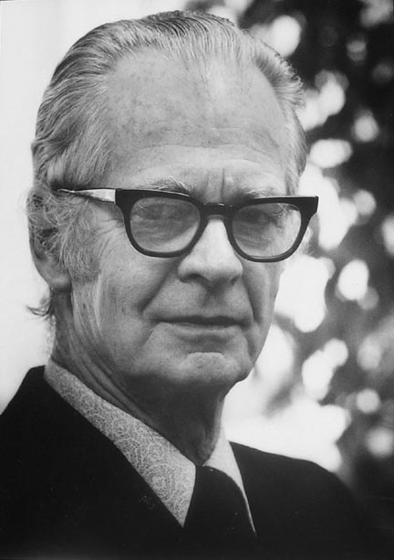
Educational Theorists
Behaviorists Theorist:
B.F. Skinner: Learning is not doing; it is changing what we do. We may see that behavior has changed, but we do not see the changing. Since the observable effects of reinforcement are usually not immediate, we often overlook the connection. Behavior is then often said to grow or develop.

Slide 5
Behaviorism
Focuses on objective observable behaviors.
Rejects structuralism or configuration.
Behavior is shaped through positive and negative reinforcement.
Frames instructional goals in specific, behavioral, observable terms.
Concerned with immediate, recognizable changes in behavior.
ACTIVITIES: Reading, review, and analysis of provided text and materials. Individual work submitted directly to instructor for review. Structured assignments directly linked to learning objectives. Little or no cohort discussion.

Slide 6
Behaviorism Cont.
Student’s Role:
To absorb instructional presentations and material, and use them to create performances which indicate attainment of correct mental models.
Instructor’s Role:
To present effectively structured material, and assess student’s proper and complete understanding of it. The instructor is the focus of presentation and interaction. Tutorial relationship to individual students.

Slide 7
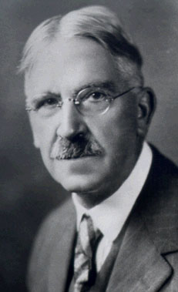
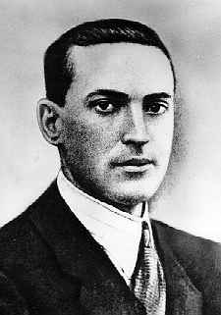
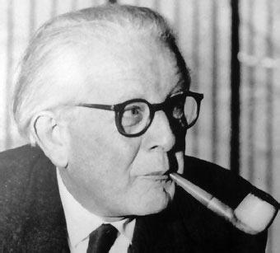
Educational Theorists
Constructivism Theorists
J. Dewey: Learning is active. It involves reaching out of the mind. Learning means something which the individual does when he or she studies. They learn in consequence of their direct activities. Thinking is the method of intelligent learning, of learning that employs and rewards the mind.
J. Piaget: A developing child builds cognitive structures, such as, mental maps, schemes, or networked concepts for understanding and responding to physical experiences within his or her environment.
Vygotsky: Culture is the prime determinant of individual development.

Slide 8
Constructivism
By reflecting on our experiences, we construct our own understanding of the world we live in.
Teachers seek the student's point of view in order to understand student learning for use in subsequent conceptions.
Students primarily work in groups and engage in discussions.
Teachers generally behave in an interactive manner mediating the environment for students.
ACTIVITIES: Emphasis on discussion and collaboration among cohort of students. Application of principles to case studies and projects. Open-ended assignments linked to changing learning objectives. Assignments constructed to reflect "real world" conditions and requirements.

Slide 9
Constructivism Cont.
Student’s Role:
To explore the learning environment in concert with others and construct meaning from learning experiences. To apply knowledge in personally meaningful contexts.
Instructor’s Role:
To construct a learning environment, and assist students as they explore it by designing experiences that encourage absorption and accommodation. Lasting learning comes as a result of activities that are both meaningful to the learner and based in some social context (other learners, colleagues, instructors, clients, etc.).

Slide 10
Cognitivism
It's important to present all the necessary lower-level facts before proceeding to teach at higher levels.
Combination of concrete, pictorial then symbolic activities will lead to more effective learning.
Focuses on the inner mental activities – opening the “black box” of the human mind is valuable and necessary for understanding how people learn.
Skills of Cognitivism: Gain attention, Inform objective, Recall learning, Present new material, Provide guidance, Eliciting performance, Feedback, Assess lesson, and Enhancing retention and recall.

Slide 11
Cognitivism Cont.
Learning Process:
Learning takes place when information is received into the mind and then processed to make sense of it. Learning new information is made possible by connecting it to existing information and then storing it so it can be retrieved later.
Instructor’s Role:
To present new information in a way that helps the learner attend to, encode and retrieve information. The teacher should organize information and help students link it to existing information.

Slide 12
Educational Psychologist
Key Information:
Brain Research
Learning Styles and Multiple Intelligences
4 Mat
Bloom’s Taxonomy
Motivation
Developmental Trends

Slide 13
Brain Research
People think in two different ways: Right Brain (R-B) and Left Brain (L-B)
R-B traits: Intuitive, spontaneous, prefer essay tests
L-B traits: Sequential, logical, prefer multiple choice tests
Teachers instruct their classroom in accordance to what side of the brain they happen to be.
R-B Teacher: Prefer activities, groups, and noisy classroom.
L-B Teacher: Prefer lectures, individual work, and peaceful classroom.
R-B Students: Prefer making projects and groups.
L-B Students: Prefer writing assignments and working alone.

Slide 14
Learning Styles
Visual Learns
  When spelling you must imagine the word.
Auditory
  When spelling you must sound the word out.
Kinesthetic &Tactile
  When spelling you must write the word down.

Slide 15
Multiple Intelligences
Verbal – Reading and writing
Logical – Computer skills and math
Visual – Images and graphs
Bodily – Coordination and dexterity
Musical – Music and rhythmic movements
Interpersonal – Communication with others
Intrapersonal – Communication with one's self
Naturalist – Plants and animals

Slide 16
4 MAT (ways to teach better)
Innovative Learners
  By talking
    Debates
Analytic Learners
  By lectures
    Stories about lessons
Common Sense Learners
  By hands on activities
    Experiments
Dynamic Learners
  By risk taking
    Strategic games

Slide 17
Bloom’s Taxonomy
Three domains of educational activities
  Cognitive (Knowledge)
  Affective (Attitude)
  Psychomotor (Skills)
Cognitive
  Recall information, separate concepts , and build patterns
Affective
  Active participation and placing priorities
Psychomotor
  Habitual movements and imitation

Slide 18
Motivation
Intrinsic
  Motivation in the students
  Learning is important to the student
Extrinsic
  Doing to children to cause motivation (assignments)
  Punishments and rewards
  Need a single person in power

Slide 19
Developmental Trends
Primary (Grade schools)
  Manipulate real world objects
    Ex. Math lessons with blocks
Intermediate (Middle/Jr. High schools)
  Connect real world objects with abstract ideas
    Ex. Test seeds and theories on plant growth
Secondary (High school)
  Establish unique identity
    Ex. Write a personal poem

Slide 20
Curriculum Specialist
This portion of the lesson will be an overview of how to assess students, use standards, prepare students for the real world, etc.
The Curriculum Specialist will cover: 21st Century Skills, National Educational Technology Standards, Academic Standards, Teaching with the Standards, and Assessment.

Slide 21
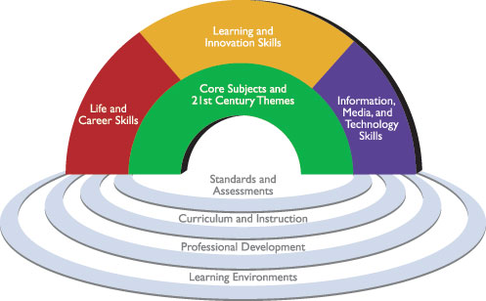
21st Century Skills
Diagram of key elements of 21st century learning. Rainbow (Top)- Student outcomes; Ripples (Bottom)-Support System.
Rainbow are skills, knowledge, and expertise students should master to be successful in life and work.
Ripples are in place to ensure mastery of 21st skills.
In addition to the students state core.
Prepare students for what will be expected of them in the future, whether it is college or the workforce.
Helps students understand life and work are increasingly complex and how to deal with these problems.

Slide 22
National Educational Technology Standards (NETS)
NETS for Teachers
Engages students with real world and authentic problems using digital tools and resources.
Uses digital tools for students to collaborate and communicate with other group members.
Teachers need to understand what the community is like they are teaching in.
If there are diverse learners in classes they need to have all needs met to perform at their best ability.
Teachers need to continue their education to become a better teacher every year.
NETS for Students
With knowledge students already know they create new ideas and products.
Students collaborate in groups face-to-face and virtually.
Students use digital tools to do research projects.
During the research process students use critical thinking skills for the overall goal of the project.
Students have proficiencies they have to accomplish before leaving grades K-4, 5-8, 9-12.

Slide 23
Academic Standards
These are the standards students are expected to know, understand and be able to do.
These standards are what teachers think will make students successful in college or the workforce.
Every state has their own standards, but standards are going to have the same characteristics.
Standards are in place for students, who transfer to a different school in the same state they will not be far behind.

Slide 24
Teaching With The Standards
When teaching standards teachers can implement more than one standard in each lesson. This will allow teachers to cover more standards and not feel crunched for time.
At the beginning of the course teachers need to inform students of the standards covered during the course.
Teachers need to have rubrics because students need to know what is expected of them during the lessons.
Real world problems will have students collaborating and engaged in the lesson more because they feel they can make a difference.
Have essential questions to have students critically thinking and thinking deeper into the lessons.

Slide 25
Assessment
There are a lot of ways to assess students. Not one way is the best.
Define the assessment so students have a complete understanding of what is expected of them.
Having an authentic assessment will provide a more clear way to grade students.
There should be rubrics and standards in place for students to understand how to complete assignments.
Teachers should incorporate technology to make the lessons more effective and efficient.
By providing an authentic assessment it will allow students to think more critically.
If an authentic assessment, rubric and task is the way to go then visit this website to create authentic assessments.

Slide 26
Pedagogy Specialist
The art, science, or profession of teaching. The principles and methods of instruction, how one teaches.
This portion of the presentation will look at how teachers teach
Different methods of instruction to reach students on a personal level
The role of the teacher and the student in the classroom
What are engaged learners and how can teachers achieve them
Provide positive feedback and assessment

Slide 27
Methods of Instruction
Outcome Based: Teach to the bigger picture, not all students will be attending college after high school, keep those students in mind. Teach for a desired outcome, students should leave the classroom with a wide array of knowledge that will help them with any path they take.
Collaborative: Allow students to work together in groups to share ideas and get input from their peers. Open the classroom up to debates so and free flowing ideas.
Socratic Learning & Questioning: Ask students questions to get the desired outcome. This forces students to think critically, the answer is not always the most obvious.
Technology Integration: Use of technology should be transparent, and it should support the curricular goals, and help students to efficiently reach their goal.

Slide 28
Role of Students and Teacher in the Classroom
Encourage students to be critical thinkers.
Challenge students so they don't get bored and lose interest.
Open classroom up for debates, and class discussions so students can get insight from how their peers think and feel.
Change up the instruction method used because students all learn in different ways.
Empower students with technology and educational tools in the classroom

Slide 29
Empowering the Students
Relate lessons to real world situations.
Give students curriculum they can relate to.
Use technology to support teaching methods, not take them over.
Inform students of the big ideas and essential questions, performance requirements, and evaluative criteria at the beginning of the unit or course.

Slide 30
Instructional Designer
Key Information:
Teaching for Understanding
Understanding by Design/Backward Design
Developing Effective Goals and Objectives
Technology Integration
Literacies
Differentiating Instruction

Slide 31
Teaching for Understanding
The unit or course design
The Teacher
The Learners
In the classroom environment

Slide 32
Understanding by Design/Backward Design
Identify desired results
Determine acceptable evidence
Plan learning experiences and instruction

Slide 33
Developing Effective Goals and Objectives Levels
1: Knowledge
2: Comprehension
3: Application
4: Analysis
5: Synthesis
6: Evaluation

Slide 34
Technology Integration
Elements Present in Good Models of Teaching with Technology:
1. Standards: Model must be aligned with local, state, and national standards.
2. Assessment: Model must clearly identify indicators of success to the student.
3. Accessibility: Model must meet the needs of all learners including those with special needs.

Slide 35
Strategies of Learning
Active Learning-Curricular activities rely on virtual and/or real controlling materials.
Constructive Learning-Students construct their own understanding building on what they already know.
Authentic Learning-Real world tasks and primary sources connect learners to the world around them.
Cooperative Learning-Students work in groups with specific tasks or roles assigned.
Intentional/Reflective Learning-Students are encouraged to generate their own questions and explain their problem solving strategies.

Slide 36
Steps on How to Differentiate Instruction
Step 1- Know Your Students
Step 2-Have a Repertoire of Teaching Strategies
Step 3- Identify a Variety of Instructional Activities
Step 4- Identify Ways to Assess or Evaluate Student Progress

Slide 37
Energy Innovation Unit
This unit relates to the constructivist theory by incorporating physical activities that promote learning about energy resources. The unit constructs experiments that force the students to find and evaluate alternate energy sources, such as alternate source of fuel for cars. Then conducting an appliance survey and comparing how countries are similar or different in their energy use.
The project is active, it forces students to step outside of the box. They learn to set goals, monitor progress, provide feedback, assess thinking, processes, performances, and products. As well as reflecting on their learning.

Slide 38
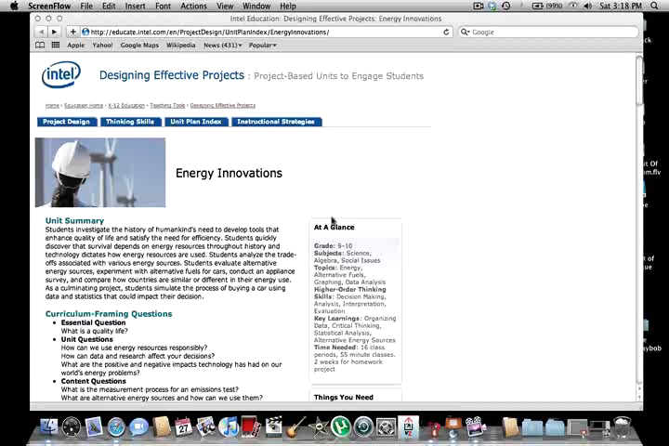
Energy Innovation

